Slide 1
CMPE 272 MARKET-PLACE PROJECT
Team Members:
1. Shreekar Kolanu : 017406493
2. Satwik Upadhyayula : 017423796
3. Vineet Samudrala : 017426253
4. Bala Supriya Vanaparthi : 017464135

Slide 2
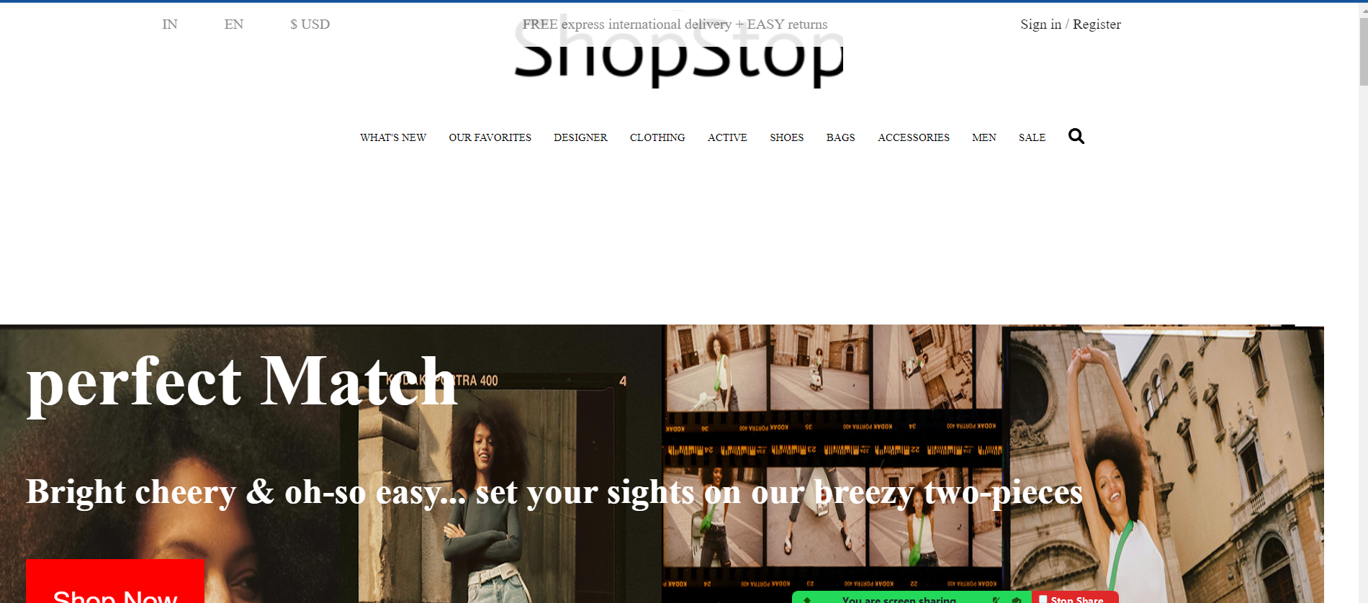
SHOP STOP MARKETPLACE
Developed a one stop marketplace for users that offers combination of Shoes, clothes, accessories and discount sale.

Slide 3
ARCHITECTURE
Robust Tech Stack : Used HTML , CSS , Javascript and PHP for a interactive user interface and AWS for scalability.
Architecture : Tailored architecture for marketplace including clothing, shoes, Bags and accessories offering unique items and pricing.
Database: Using Aws dynamo db for database management and no sql scalability with data protection.
Features- Integrated Amazon login and Facebook login authentication with cart items and payment interface using checkout feature including payment methods like UPI, Paytm and COD

Slide 4
SHOP STOP MARKETPLACE FEATURES
The website offers exclusive items for clothing for mens and womens itenary.
Explore exclusive deals and discounts on new sales.
Integrated multiple payment methods.
Added Exclusive discounts and Sales , Favourites marked by the users.

Slide 5
Shop Stop One Stop Solution For The Marketplace
Convenience : Single point of contact for all the needs
Transparency: Great discount on the sales and clothing, shoes, bags!
Flexibility : Access to multiple marketplace items and itineraries

